Slide 1
Comprehensive digital marketing project work
Apollo hospital

Slide 2
LIST OF GROUP MEMBERS
Adari Navya – 720131605197 (Group Leader)
Buddharaju Sreya – 7201316050207
Athika Firdous – 7201316050199
Behara Partha Sarathi – 7201316050204
Bariki Mary Meghana - 720131605010

Slide 3
Part.1: brand study, competitor analysis & buyer’s\audience’s persona
RESARCH BRAND ; APOLLO MISSION TO BRING HEALTH CARE OF INTERNATIONAL STANDERD WITHIN THE REACH OF EVERY INDIVIDUAL.
VISION : APOLLO VISION FOR THE NEXT PHASE OF DEVELOPMENT IS TO TOUCH A BILLION LIVES .
USP [ UNIQUE SELLING PROPOSITIN ] : AUTOMATED SYSTEM FOR GETTING APPOINTMENT

Slide 4
PART 1: BRAND STUDY, COMPETITOR ANALYSIS & BUYERS\AUDIENCE PERSONA
ANALYZE BRAND MESSEGING: USE APOLLO WITH LINKEDIN TO SEND P PERSONALIZATIN MESSAGES ; APOLLO.IO
EXAMINE THE BRANDS TAGLINE: TOUCHING LIVES

Slide 5
PART 1: BRAND STUDY,COMPETITOR ANAYSIS &BUYERS/AUDIENCE PERSONA
COMPETITOR ANALYSIS : THE THREE COMPETITORS OPERATING IN THE SAME INDUSTRY NICHE AS CHOOSEN BRAND EXAMINATION THEIR USPS AND ONLINE COMMUNICATION
COMPETITOR 1: ENTER PRISE LTD.
COMPETETOR 2: ASTER DM HEALTH CARE LTD.
COMPETETOR 3: FORTIS HEALTH CARE LTD.

Slide 6
PART1: BRAND STUDY,COMPETITOR ANYLISIS BUYERS\AUDIENCE PERSONA
CLEARLY DEFINE THE AUDIENCE FOR THE APOLLO HOSPITAL CONSIDER DEMOGRAPHICS PHYCOGRAPHIS BEHAVIOUR & INTREST .
The core purpose of customer value driven marketing strategy choice of target customers is critical customer in the health care facilities in industry
Apollo hospitals can use the following four steps to build strategy health care
1.Market segmentation
2.Targeting
3.Differentation

Slide 7
4. positioning
DEMOGRAPHIC SEGMENTATION : Demographic segmentation is dividing the mass market into smaller segments the group based on gender ,income, occupation , age, life cycle stage one of the most widely used.
TARGETTING AND HOW APOLLO HOSPITALS WORK: After identification of various
Consumer segments within the marketplace apollo hospital need to target specific market regulatory and other entry barriers and technological barriers financial return potential

Slide 8
SEO & Keyword Research
SEO Audit: Do an SEO audit of the brands website
Keyword Research: Research Objectives, Brainstorm Seed Keywords, Utilize Keyword Research Objective. Analyze competitor research objectives and have lower competition higher conversation potential.
On page Optimization: Everybody knows but whats unique about their strategy is that they use a combination of traditional.
Apollo Hospitals have done an excellent job of levaging online channels to reach out their target.
Created an informative content on their website and social media account. Running campaigns to promote awareness. Employed a strong SEO strategy which have improved their visibility on search engine results pages and enable them to reach

Slide 9
Content Ideas and Marketing Strategies
Content Idea Generation & Strategy:
July 17th - July 23rd Theme: Apollo's Community Impact
July 20th - Instagram Post: Topic: "Apollo Cares: Giving Back to the Community" Description: Highlight Apollo's community outreach programs and initiatives.
July 22nd - Blog Post: Title: "Promoting Mental Health Awareness" Description: Discuss the importance of mental health awareness and share resources for seeking help.
Week 4: July 24th - July 31st Theme: Patient Stories and Testimonials
July 26th - Twitter Post: Topic: "A Heartwarming Journey to Recovery ❤️" Description: Share a touching patient testimonial about their experience at Apollo Hospitals.
July 29th - Instagram Post: Topic: "Thank You for Trusting Apollo Hospitals 🙏" Description: Express gratitude to patients and their families for choosing Apollo for their healthcare needs.
July 31st - Social Media Roundup: Topic: "July Highlights: Moments to Remember" Description: Recap the month's key events, health tips, and patient stories.

Slide 10
Content Ideas and Marketing Strategies
Marketing Strategies Process at Apollo Hospitals:
Market Research: Apollo Hospitals likely begins by conducting extensive market research to understand the healthcare needs of the local and international communities they serve. This involves analyzing demographic data, healthcare trends, competitors, and patient feedback to identify areas of improvement and opportunities.
Brand Positioning: Based on the market research, Apollo Hospitals positions itself as a leading healthcare provider, emphasizing its expertise, cutting-edge technology, and patient-centric approach. They may also focus on specific medical specialties to establish themselves as leaders in those fields.
Multi-channel Marketing: Apollo Hospitals employs a multi-channel marketing approach to reach its target audience effectively. This includes traditional advertising (TV, radio, print), digital marketing (website, social media, email campaigns), and partnerships with healthcare professionals.

Slide 11
Content Marketing: Content marketing plays a vital role in educating the public about health-related topics, sharing success stories, and building trust. Apollo likely creates valuable and informative content such as blogs, articles, videos, and infographics.
Medical Tourism Promotion: As a well-known destination for medical tourism, Apollo Hospitals likely invests in marketing efforts targeting international patients seeking high-quality medical services at competitive prices.
Community Engagement: Apollo Hospitals engages with local communities through health awareness programs, free medical camps, and partnerships with NGOs to address health issues prevalent in the region

Slide 12
Challenges Encountered:
Cost Management: Providing world-class healthcare services can be expensive. Apollo Hospitals faces challenges in balancing the need for quality care while managing costs to remain competitive and accessible.
Competitive Landscape: The healthcare industry is highly competitive. Apollo faces competition from other hospitals, clinics, and medical facilities. Staying ahead in terms of medical advancements and patient satisfaction requires continuous effort.
Regulatory Compliance: The healthcare industry is subject to strict regulations and compliance standards. Apollo must navigate complex legal requirements to ensure smooth operations and avoid penalties.

Slide 13
Reputation Management: As a leading healthcare provider, Apollo Hospitals must be proactive in managing its reputation. Any negative publicity or patient dissatisfaction can significantly impact their brand image.
Technological Advancements: Keeping up with rapidly evolving medical technology is a challenge. Apollo needs to invest in the latest equipment and training to maintain its reputation for cutting-edge healthcare.

Slide 14
Lessons Learned:
Patient-Centric Approach: Apollo Hospitals' success is largely attributed to its patient-centric approach. They prioritize patient care, comfort, and satisfaction, leading to positive word-of-mouth and repeat business.
Continuous Innovation: To stay ahead in the healthcare industry, Apollo Hospitals focuses on continuous innovation, adopting the latest medical technologies and treatments to offer the best possible care.
Holistic Marketing: Apollo uses a well-rounded marketing strategy, combining traditional and digital marketing channels. This approach allows them to reach a broader audience and engage with patients through various touchpoints.

Slide 15
Brand Building: Building and maintaining a strong brand reputation is critical. Apollo's focus on quality healthcare and positive patient outcomes has helped establish trust and credibility.
Corporate Social Responsibility (CSR): Apollo's community engagement initiatives, such as health camps and awareness programs, not only benefit the community but also enhance the hospital's reputation as a socially responsible organization.

Slide 16
Content Creation and Curation
Post Creation:
As per the 3 different content formats relevant to Apollo Hospitals are:
Content 1 :- Health Articles and blogs, informative article and blog poses about various medical topics, health tips and updates related to Apollo Hospital Services and Advancements and well new tips.
Content 2 :- Patient testimonials and success stories. Real life accounts from patients who have received treatments at Apollo Hospital, sharing their experience and outcomes.
Content 3 :- Health videos and info graphics visual content such as videos and info graphics explaining medical procedures health conditions and prevention measures

Slide 17
Research and Brainstorm :- Research trending topics industry news or audience invest within each category.
Divided Announcement :- Company announced a divided of Rs. 90 for share on 30 May within record date of 19 August, 2023.
Employee & Interest Expense :- Company has spent 229 of its operating revenue towards interest. Expenses and 129.1 towards enpayee
Stock returns us Nifty 100 :- Stock gave a 3 year return of 219.3 as compared to Nifty 100.

Slide 18
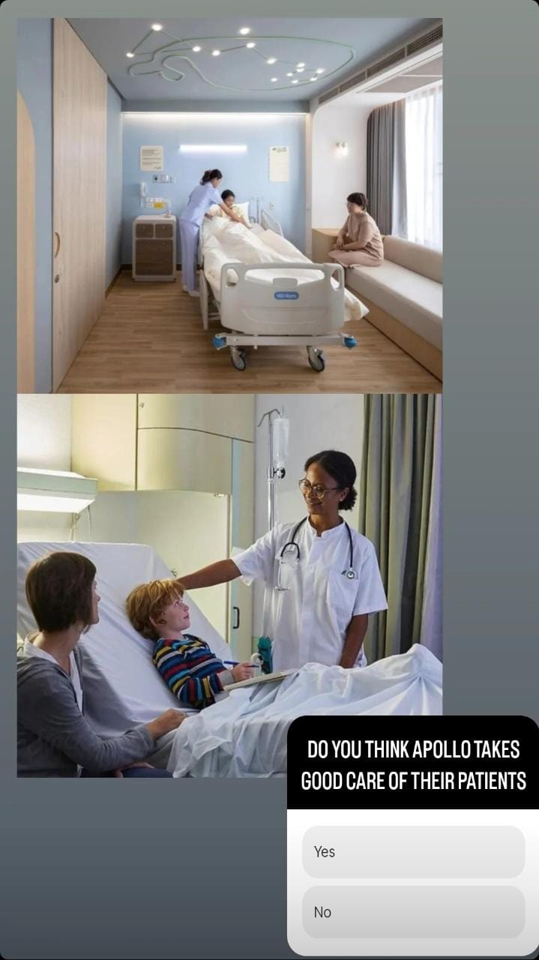
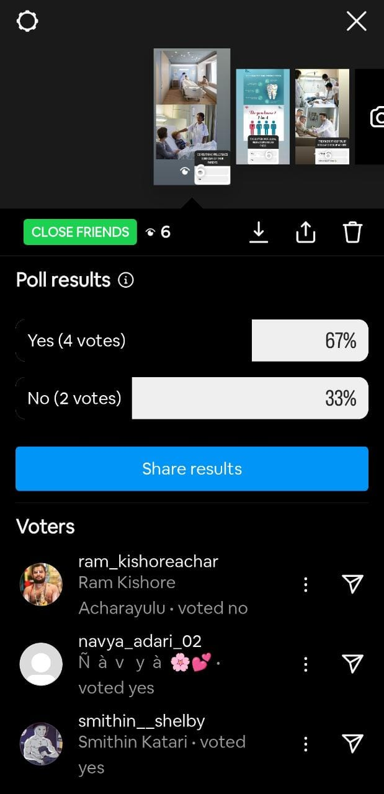
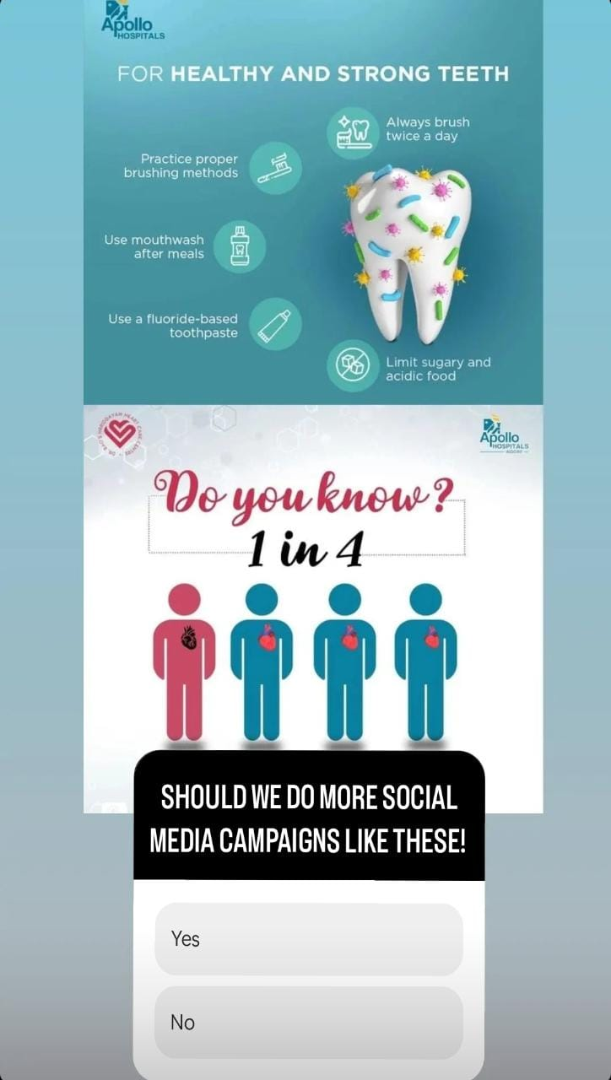
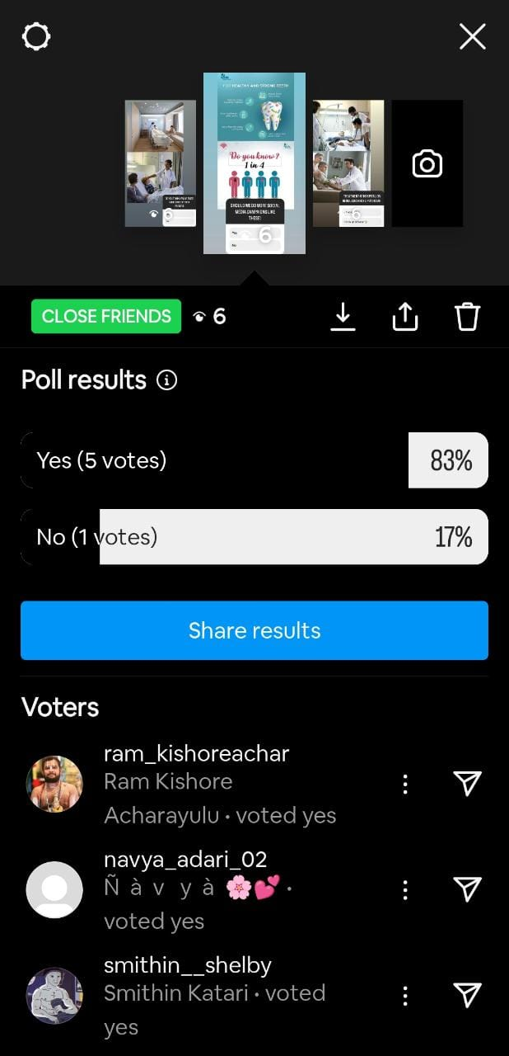
Content Creation and Curation Instagram Story

Slide 19

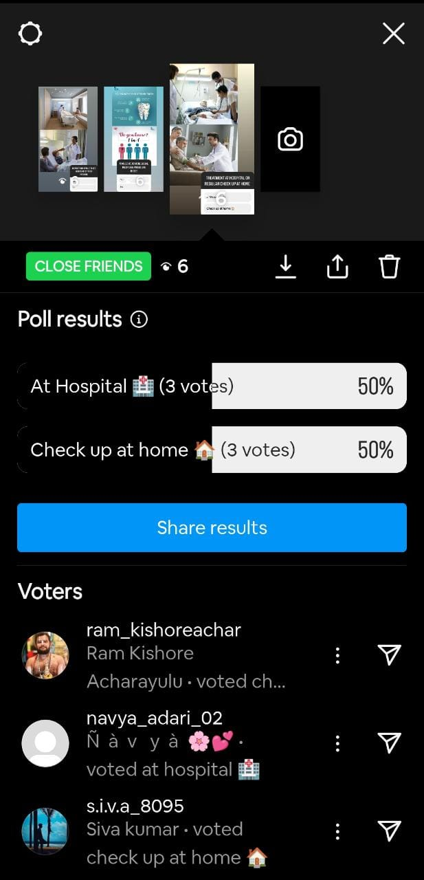

Slide 20

Content Creation and Curation Designs/Video Editing

Slide 21


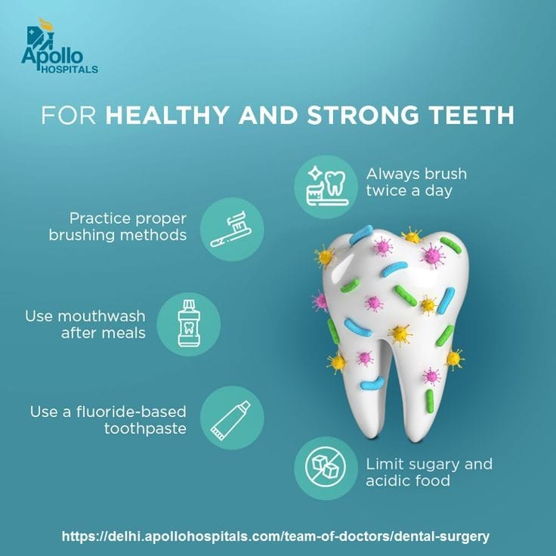
Content Creation and Curation Social Media Ad Campaigns

Slide 22
Content Creation and Curation Email Ad Campaigns
Ad Campaigns for email marketing:
The primary objective of an email marketing ad campaign is to engage recipients, drive action, and ultimately generate leads, sales, or conversions. Here are the key components and steps involved in creating an effective ad campaign for email marketing:
Define Your Objectives: Clearly outline the goals you want to achieve through the email campaign. It could be increasing sales, promoting a new product, driving website traffic, building brand awareness, or nurturing leads.
Identify Your Target Audience: Understand your target audience's preferences, interests, and pain points. Segment your email list based on relevant criteria to send more personalized and relevant content.
Craft Engaging Content: Create compelling email content that grabs the recipient's attention. Use catchy subject lines, personalized greetings, and visually appealing layouts. The content should be concise, clear, and have a strong call-to-action (CTA).

Slide 23
Design Responsive Templates: Ensure that your email templates are mobile-friendly and responsive to various devices and screen sizes. This way, your emails will display correctly and engage users on both desktop and mobile devices.
Schedule Email Sequences: Plan the frequency and timing of your emails. Sending a series of emails over time (email sequences) can be more effective than a single email. For instance, you may send a welcome email, followed by a series of informative emails and then promotional offers.
A/B Testing: Run A/B tests on different elements of your emails, such as subject lines, CTAs, visuals, or even the email copy. Analyze the results to optimize your emails for better performance.
Measure and Track Results: Use email marketing analytics to track the performance of your campaign. Monitor metrics like open rates, click-through rates (CTR), conversion rates, and unsubscribe rates. This data will help you understand what's working and what needs improvement.

Slide 24
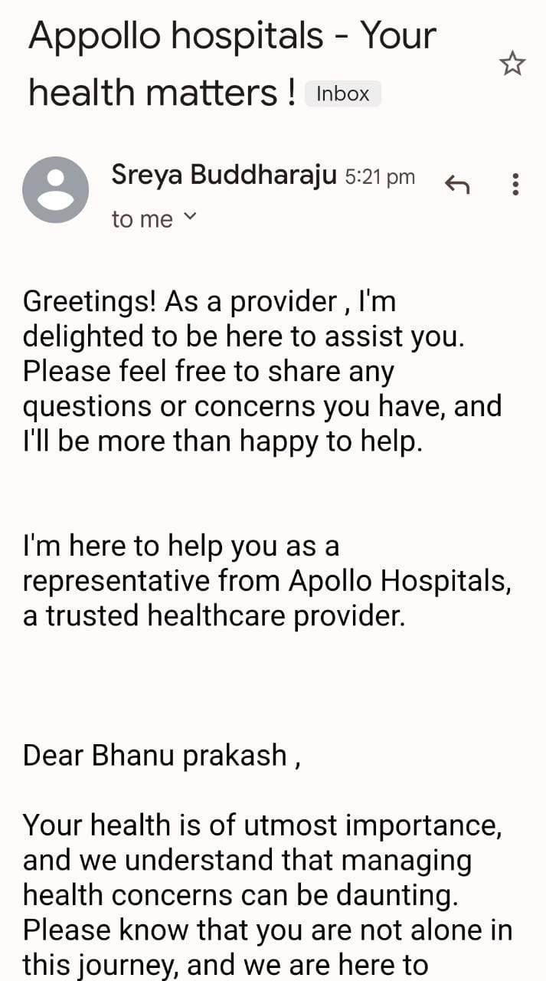
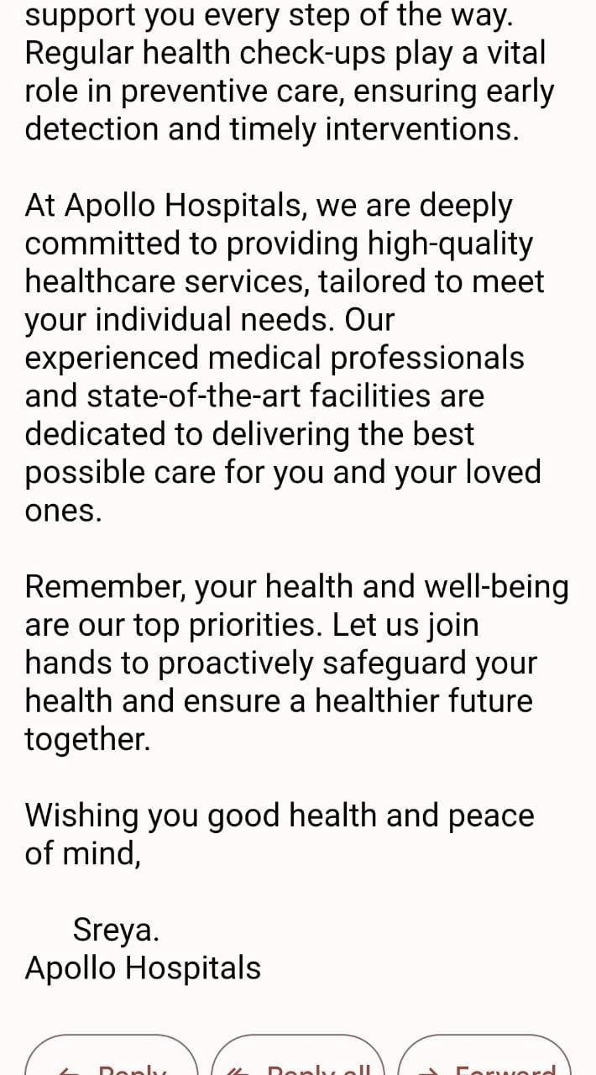
Email Ad Campaign 1 Brand Awareness

Slide 25
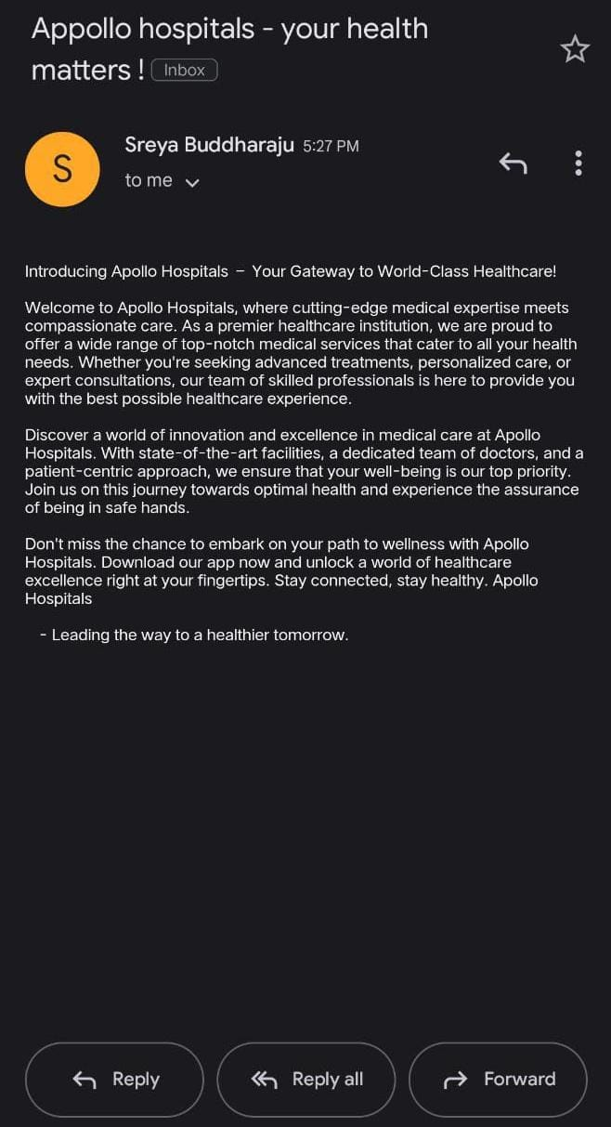
Email Ad Campaign 2 Lead Generation

Slide 26
Content Creation and Curation
Content Creation:
Medical Expertise: Apollo Hospitals, being a prominent healthcare provider, likely emphasizes collaborating with medical experts, doctors, and specialists in creating content. This ensures that the information presented is accurate, reliable, and up-to-date.
Audience-Centric Approach: Like any successful content strategy, Apollo Hospitals would likely focus on understanding its target audience's needs, preferences, and pain points. By addressing specific healthcare concerns and providing valuable insights, they can engage effectively with their audience.
Diverse Content Formats: To cater to different learning styles and interests, Apollo Hospitals may utilize a variety of content formats, such as articles, blog posts, videos, infographics, patient stories, health tips, and interactive tools.
Health Awareness Campaigns: Apollo Hospitals might run health awareness campaigns on specific topics to educate the public about critical health issues, prevention, and early detection. Such campaigns aim to create a positive impact on public health.
Patient Education: Educating patients about their medical conditions, treatment options, and aftercare is essential for empowering them to make informed decisions about their health.

Slide 27
Content Curation:
Source Selection: Apollo Hospitals might curate content from reliable and authoritative sources within the medical community. This ensures that the curated content is accurate and trustworthy.
Health and Medical News: Curated content could include the latest medical research, breakthroughs, and advancements in healthcare to keep the audience informed about cutting-edge developments.
User-Generated Content: Apollo Hospitals may engage with its audience by curating user-generated content such as patient testimonials, success stories, and health-related experiences. This fosters a sense of community and trust.
Patient Resources: Curated content could include informative resources, such as health guides, FAQs, and downloadable materials, to provide valuable support to patients and their caregivers.

Slide 28
Challenges:
Medical Accuracy and Credibility: Providing accurate and credible medical information is critical in the healthcare industry. Ensuring that the content is reviewed and approved by medical experts while keeping it accessible to the general public can be a challenge.
Multilingual Content: Apollo Hospitals serves a diverse audience with various language preferences. Creating and curating content in multiple languages to reach a broader segment of the population can be resource-intensive and requires careful localization.
Engaging Healthcare Content: Healthcare topics can sometimes be complex and technical. The challenge lies in creating content that is not only informative but also engaging and easily understandable for a layperson.
Privacy and Data Security: Healthcare content might involve sensitive information. Ensuring that user data is protected, complying with data privacy regulations, and maintaining high-security standards are crucial considerations.
Staying Current with Medical Advancements: The healthcare industry is constantly evolving with new research and medical advancements. Apollo Hospitals would need to update its content regularly to reflect the latest information and best practices.

Slide 29
Lessons Learned:
Expert Collaboration: Partnering with medical experts and specialists within Apollo Hospitals ensures that the content is accurate, reliable, and up-to-date. It also adds credibility to the hospital's content.
Audience Research: Conducting regular audience research and feedback analysis helps in understanding the preferences, needs, and pain points of the target audience. This knowledge can guide content creation to be more relevant and engaging.
Data-Driven Decisions: Analyzing content performance metrics and user engagement data helps Apollo Hospitals identify successful content types and topics. This data-driven approach can inform future content strategy.
Localization and Personalization: Catering to a diverse audience through multilingual content and personalized recommendations enhances user experience and engagement.
Collaborative Content Creation: Encouraging contributions from various departments and teams within the hospital can bring diverse perspectives to content creation and improve its overall quality.
It's essential to understand that the challenges and lessons learned by Apollo Hospitals' content creation and curation process are likely to be dynamic, evolving as technology, audience preferences, and the healthcare industry itself change over time. For the latest information, I recommend checking Apollo Hospitals' official website or publications.

Slide 30


